Slide 1

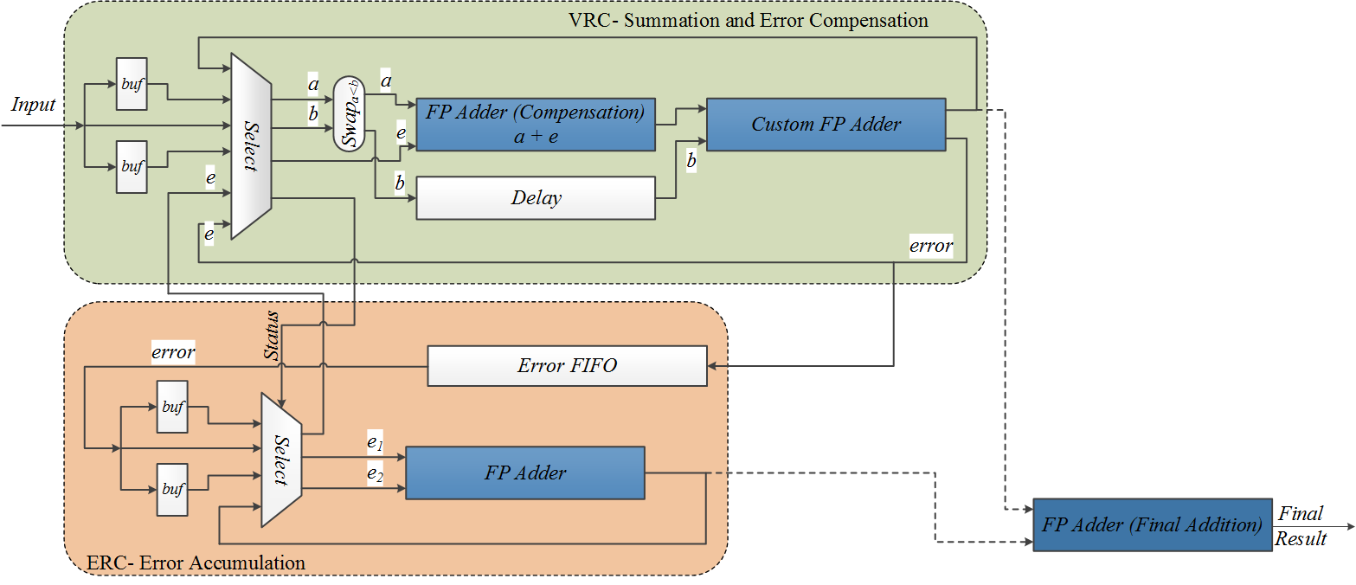
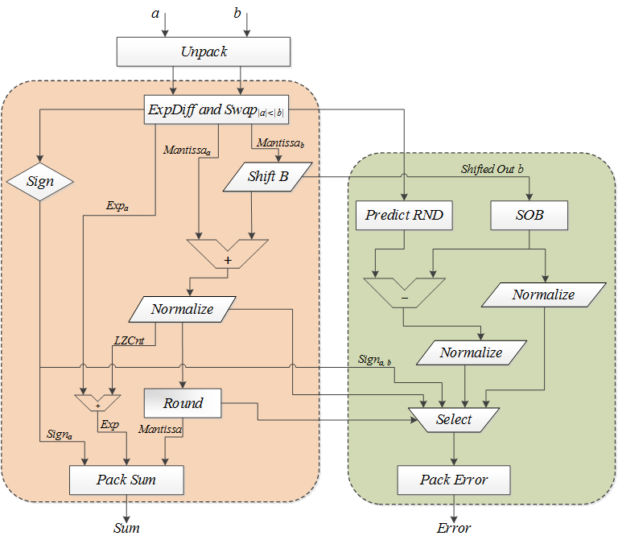
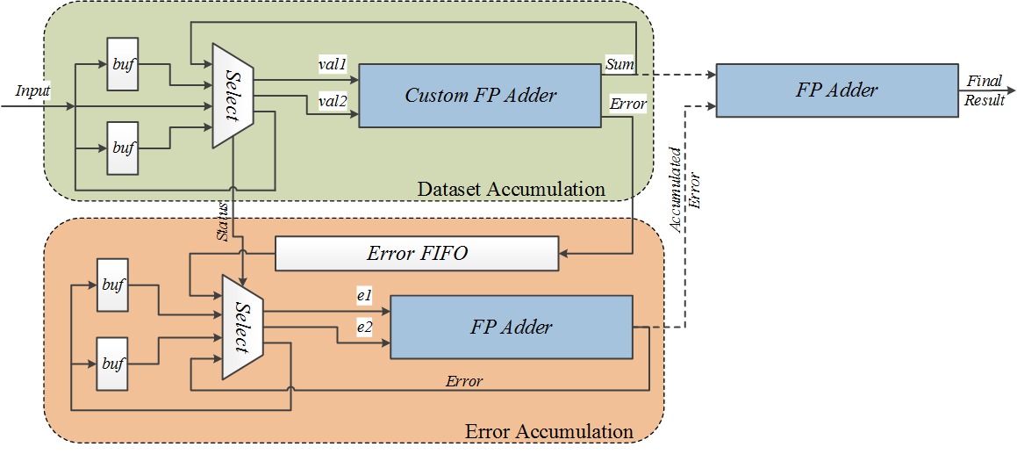
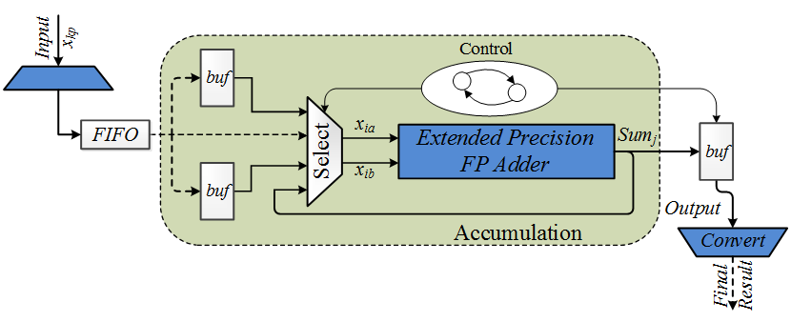
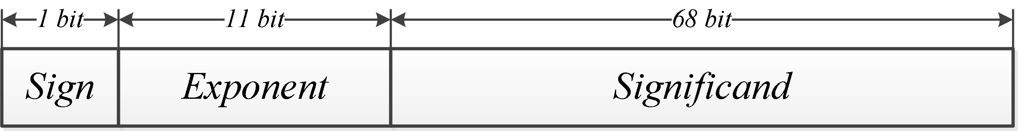
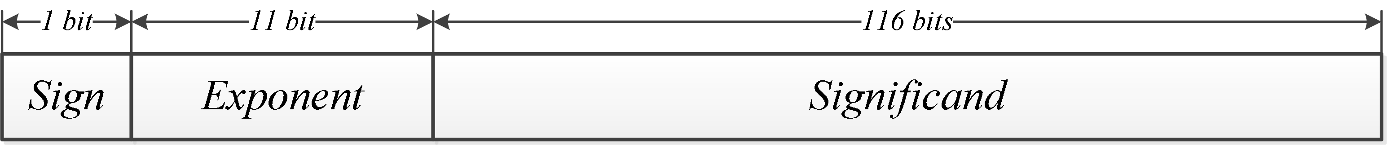
Accuracy, Cost and Performance Tradeoffs for Floating Point Accumulation
Krishna K. Nagar & Jason D. Bakos
University of South Carolina, Columbia, SC
Objective
Achieve high throughput for streaming set-wise floating point summation without sacrificing accuracy.
Issues
Data scheduling around deeply pipelined floating point adder
Accuracy of floating point summation
Streaming Set-wise Summation: Reduction Circuit
Resolves data hazards by dynamically scheduling the inputs to FP adder: Rules
d₄
c₁
d₃
d₁+d₂
c₂+c₃
g₄
g₂+g₃
e₃+e₅+e₁+e₂+e₄
g₁
d₃
d₁+d₂
c₂+c₃
c₁
Rule 1
Rule 3
Rule 5
d₃
d₁
c₂
c₁
B
A
d₂
d₁
c₂+c₃
c₁
B
e₁
d₁+d₂
c₂+c₃
c₁
Compensated Summation
Incorporate in subsequent addition
Accumulate the error and incorporate in the final result
Error Extraction: Custom floating point adder to reduce latency
Rule 2
c₃
Rule 4
Rule 6
d₄
Adaptive Error Compensation In Subsequent Addition (AECSA)
VRC accumulates input values
Error may be compensated in VRC if available
ERC accumulates the errors
ERC can supply errors to VRC
1 custom adder, 3 standard adders, Increased pipeline depth in VRC
7938 slices (+323%), 135 MHz (-28%)
Accumulated Error Compensation (AEC)
Extended Precision Reduction Circuit
All intermediate additions in extended precision
Wider, deeper adder
Wider buffers to store partial results
EPRC80: 2656 slices (+42%), 182 MHz (-3%)
EPRC128: 4600 slices (+145%), 182 MHz (-3%)
VRC accumulates input values and supplies error generated by custom adder to ERC
ERC accumulates the errors
1 custom adder, 2 standard adders
4743 slices (+153%), 176 MHz (-6%)
19 cycle 80 bit adder
26 cycle 128 bit adder
Results: Average Erroneous Bits = lg(2*Relative Error)
Relative Error = $\frac{\left|En\right|}{ε.|Sn|}$ = $\frac{\left|Sn\right|−Sn}{ε.|Sn|} , Sn calculated with infinite precision$
κ = 1.0, Varying Exp Range, Set Size = 100
Exp. Range | Red. Ckt. | AEC | AECSA | EPRC80 | EPRC128
2 | 0.9 | 0.0 | 0.1 | 0.0 | 0.0
4 | 0.8 | 0.0 | 0.0 | 0.0 | 0.0
8 | 1.4 | 0.0 | 0.3 | 0.0 | 0.0
16 | 1.8 | 0.6 | 0.7 | 0.1 | 0.1
32 | 1.7 | 0.0 | 1.0 | 0.0 | 0.0
64 | 1.9 | 0.6 | 0.8 | 0.3 | 0.3
κ = ∞, Varying Exp. Range, Set Size = 100
Exp. Range | Red. Ckt. | AEC | AECSA | EPRC80 | EPRC128
2 | 4.3 | 1.0 | 1.1 | 0.0 | 0.0
4 | 4.8 | 1.1 | 1.1 | 0.0 | 0.0
8 | 5.1 | 1.4 | 1.5 | 0.0 | 0.0
16 | 5.9 | 1.4 | 1.6 | 0.0 | 0.0
32 | 5.9 | 1.5 | 2.1 | 0.0 | 0.0
64 | 8.3 | 1.8 | 2.3 | 0.0 | 0.0
Exp. Range=0, Varying κ, Set Size = 100
κ (appx.) | Red. Ckt. | AEC | AECSA | EPRC80 | EPRC128
10 | 1.9 | 0.3 | 0.6 | 0.05 | 0.05
100 | 3.4 | 0.4 | 0.6 | 0.06 | 0.05
650 | 4.6 | 0.7 | 0.8 | 0.1 | 0.1
1800 | 6.3 | 0.7 | 0.9 | 0.3 | 0.2
5900 | 8.5 | 1.0 | 1.0 | 0.8 | 0.7
11550 | 10.5 | 1.1 | 1.3 | 1.0 | 1.0
κ = 1.0, Varying Exp Range, Set Size = 10,000
Exp. Range | Red. Ckt. | AEC | AECSA | EPRC80 | EPRC128
2 | 14.2 | 0.0 | 2.1 | 0.0 | 0.0
4 | 14.5 | 0.0 | 2.8 | 0.0 | 0.0
8 | 16.96 | 0.0 | 2.1 | 0.0 | 0.0
16 | 17.61 | 0.0 | 3.0 | 0.0 | 0.0
32 | 18.87 | 0.0 | 3.2 | 0.0 | 0.0
64 | 18.51 | 0.0 | 3.2 | 0.0 | 0.0
κ = ∞, Varying Exp. Range, Set Size = 100
Exp. Range | Red. Ckt. | AEC | AECSA | EPRC80 | EPRC128
2 | 8.2 | 1.8 | 2.2 | 0.0 | 0.0
4 | 9.2 | 2.8 | 3.2 | 0.0 | 0.0
8 | 11.5 | 4.8 | 5.3 | 0.0 | 0.0
16 | 15.5 | 5.7 | 5.9 | 0.0 | 0.0
32 | 23.3 | 6.9 | 7.1 | 1.7 | 0.0
64 | 26.2 | 9.7 | 9.7 | 0.0 | 0.0
Exp. Range=0, Varying κ, Set Size = 10,000
κ (appx.) | Red. Ckt. | AEC | AECSA | EPRC80 | EPRC128
10 | 6.7 | 1.2 | 1.6 | 0.6 | 0.5
95 | 7.0 | 1.7 | 1.5 | 0.7 | 0.5
600 | 7.8 | 1.9 | 1.8 | 1.0 | 1.0
1800 | 9.3 | 1.9 | 2.1 | 1.2 | 1.1
5900 | 10.1 | 2.4 | 2.4 | 1.8 | 1.6
11600 | 10.5 | 2.8 | 3.1 | 1.8 | 1.7
Conclusion: Accuracy improving measures reduce errors significantly
Exponent range affects the relative error: Reduction Circuit affected most, AEC, AECSA not affected much
Accuracy and throughput for set-wise summation hand-in-hand!
Condition number matters a lot and relative error increases with increase in condition number: Shows the effect of the error due to cancellation, Reduction Circuit affected most.

